Slide 1


Sathyabama institute of Science and Technology
Student Performance Prediction Using Machine Learning
43110308 - Harish M Y
43110342 - Jeevanantham S
Date : 28th Febraury 2026

Slide 2

Problem Statement
In many educational institutions, it is difficult to identify students who may perform poorly before final examinations. Teachers usually evaluate students based on periodic tests and assignments, but this method does not provide accurate early prediction.
There is no automated system that analyzes student data and predicts performance in advance.
This project aims to build a Machine Learning model that predicts student performance using factors such as study hours, attendance, internal marks, and previous scores.

Slide 3

Need for the Project
PrEarly identification of academically weak students.
ovide additional support and mentoring
Improve overall academic performance
Reduce student dropout rate
Assist teachers in making data-driven decisions.
Save time compared to manual monitoring.
This system helps institutions take preventive action before final exams.

Slide 4
Real-World Relevance
Used in schools and colleges for performance monitoring
Applied in EdTech platforms for personalized learning
Helps administrators track student progress
Supports educational data analytics
Improves student success and institutional performance
Machine Learning is widely used today in education to improve learning outcomes.

Slide 5
Objectives
To collect and analyze student academic data
To preprocess and clean the dataset
To develop a predictive Machine Learning model
To evaluate model performance using metrics
To assist teachers in early academic intervention

Slide 6
Motivation/Background
With the rapid growth of technology, educational institutions generate a large amount of student data. However, most of this data is not effectively utilized.
The motivation behind this project is to use Machine Learning techniques to convert raw student data into meaningful predictions that support academic improvement.

Slide 7
Literature Review
Previous research studies have used Machine Learning algorithms like:
Linear Regression
Decision Tree
Random Forest
Support Vector Machine
Most existing systems focus on predicting final results but do not emphasize early-stage intervention.
This project aims to provide a simple and effective prediction model for early identification of at-risk students.
.

Slide 8
Methodology
The project follows these steps:
Data Collection – Gather student academic data.
Data Preprocessing – Handle missing values and clean data
Feature Selection – Select important attributes
Model Training – Train ML model using dataset
Model Evaluation – Measure performance using metrics
Prediction – Predict student performance

Slide 9
Implementation
Programming Language: Python
Libraries Used: Pandas, NumPy, Scikit-learn, Matplotlib
Platform: Jupyter Notebook
Dataset: Student academic dataset
The model is trained using historical student data and tested for prediction accuracy.

Slide 10
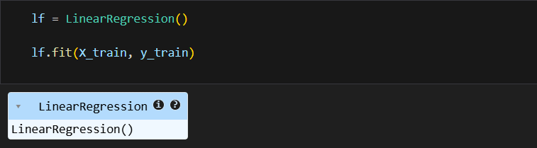
Program (Code)
Train Test Split :
Model Training (Linear Regression):

Slide 11


Program (Code)
Prediction :
Model Evaluation :

Slide 12

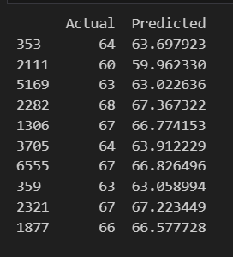
Results and Analysis
Out Put:

Slide 13
Results & Analysis
The model successfully predicts student scores.
Performance is evaluated using metrics such as:
1) Accuracy
2) Mean Squared Error (MSE)
Graphs are plotted to compare predicted and actual results.
The system helps identify students who need academic support.

Slide 14
Block
diagram

Slide 15
Conclusion
The Machine Learning model effectively predicts student performance.
It helps teachers take early corrective actions.
The system can be improved by using advanced algorithms and larger datasets
This project demonstrates the practical application of Machine Learning in education.

Slide 16



